Slide 1

MEAL DISTRIBUTION
Presented By:
Kshitij Desai
Area
Supply Chain
Objective
Determine the most orders by region and meals to allow the company to better plan for their staffing and the stock of raw materials.
Findings
The largest number of orders are in Region 56 and Center_Type A.
Italian Sandwiches has the largest number of orders.
Methodology
Exploratory analysis of meal orders
Time-series forecasting using exponential smoothing

Slide 2
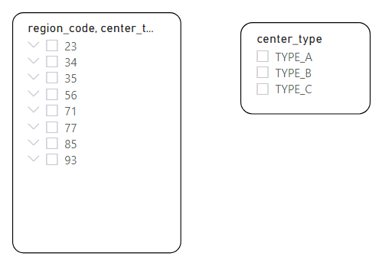
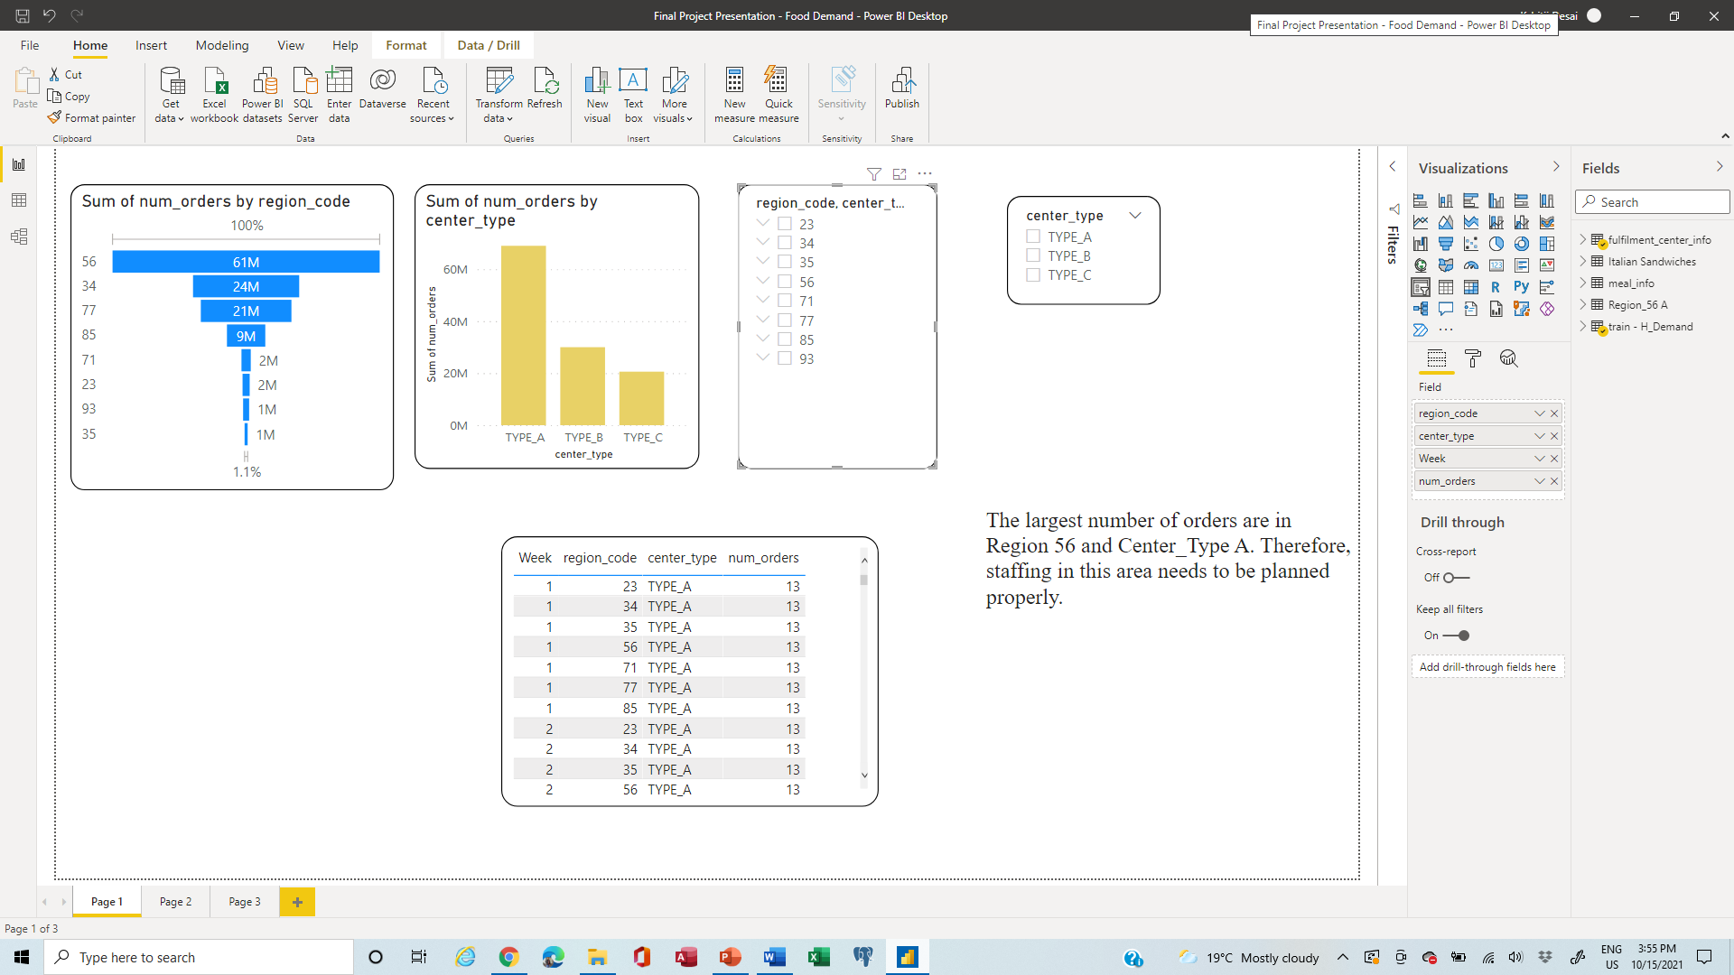
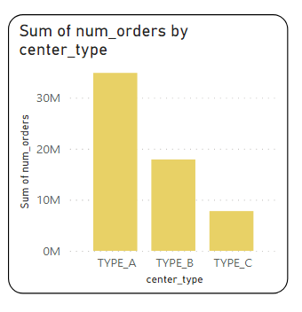
MEAL DISTRIBUTION
The largest number of orders are in Region 56 and Center Type A. Therefore, staffing in this area needs to be planned properly.

Slide 3
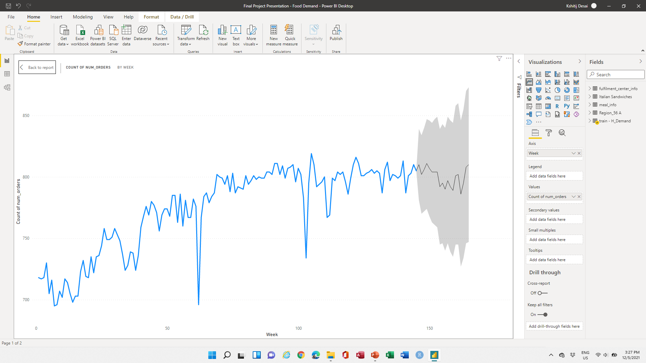
MEAL DISTRIBUTION
Period | Order Forecast
146 | 211204
147 | 211109
148 | 211015
149 | 210921
150 | 210827
151 | 210733
152 | 210638
153 | 210544
154 | 210450
155 | 210356
156 | 210261
157 | 210167
158 | 210073
159 | 209979
160 | 209885
161 | 209790
162 | 209696
163 | 209602
164 | 209508
165 | 209413
Historical Demand
Demand forecast of Region 56 and Center Type A for 20 weeks. Therefore, staffing in this area can be planned properly.

Slide 4
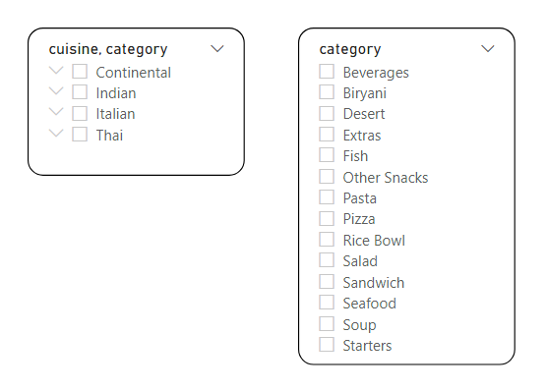
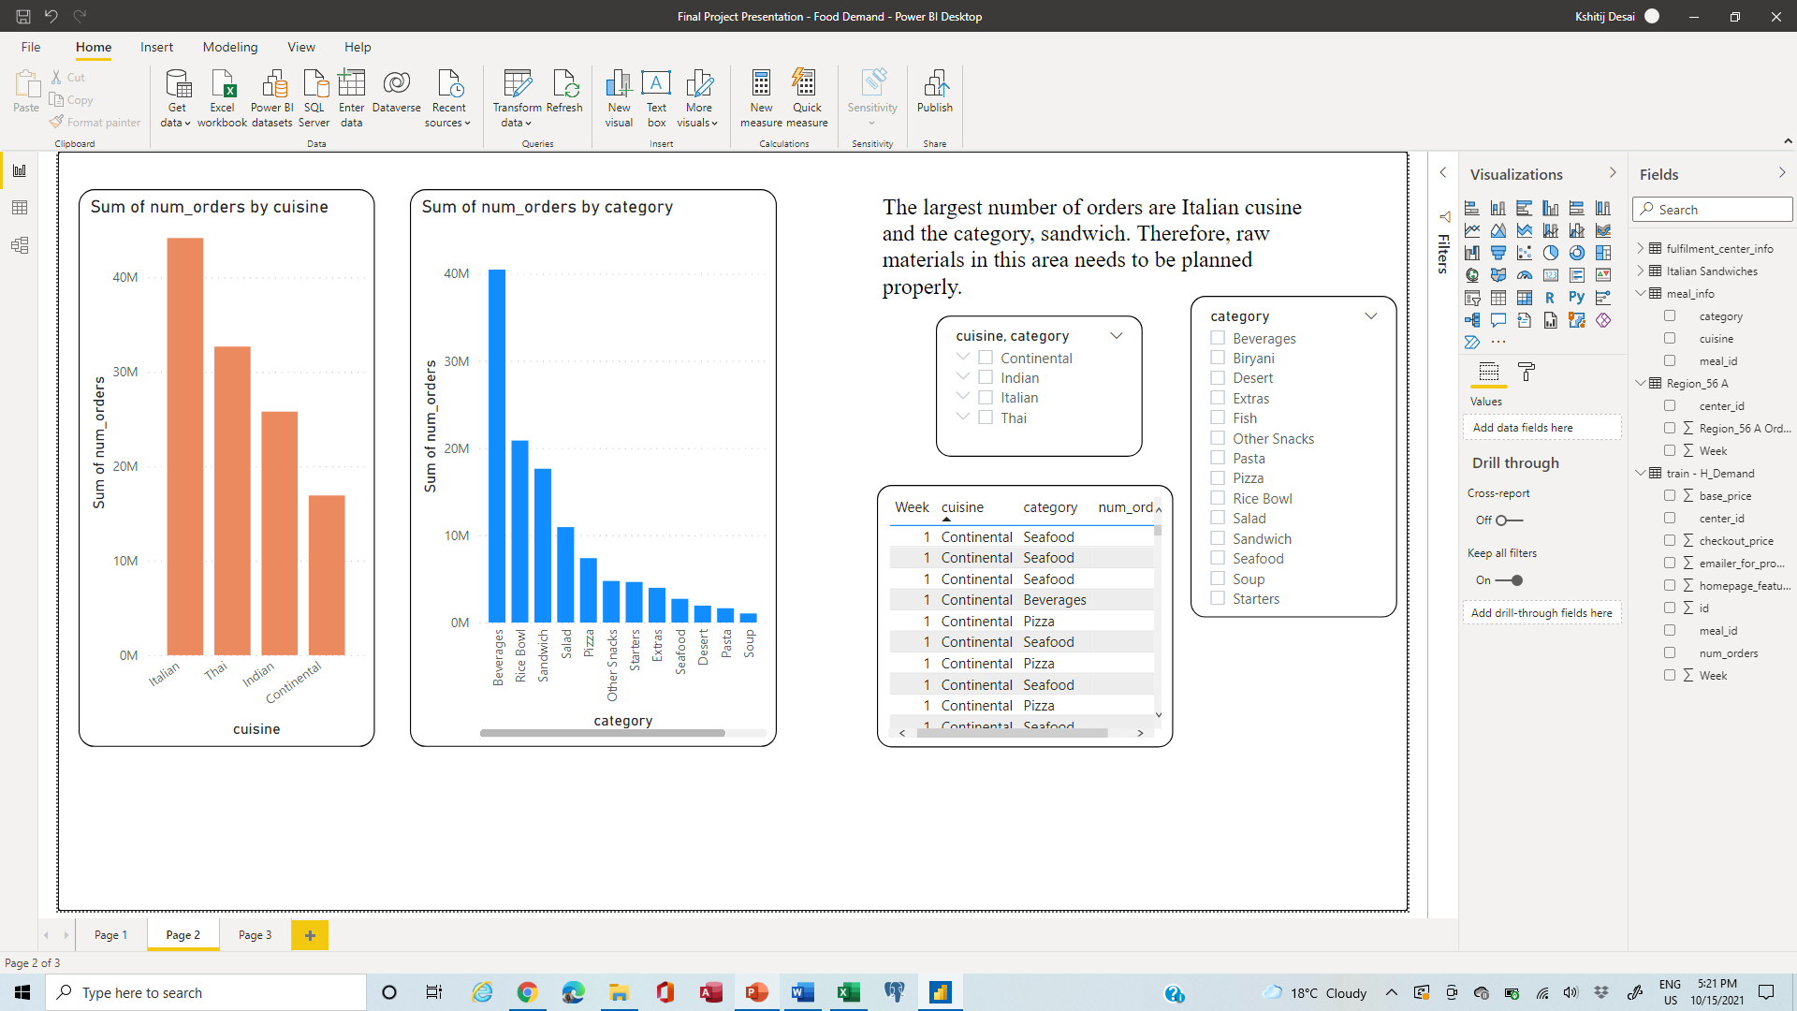
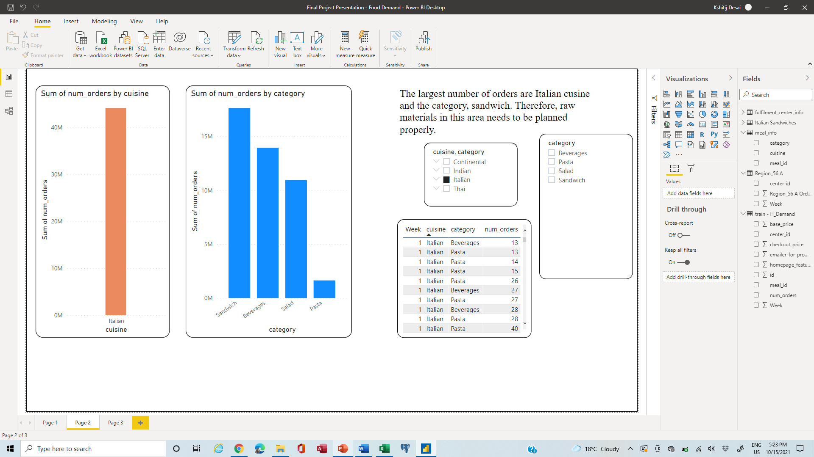
MEAL DISTRIBUTION
The largest number of orders are Italian cuisine and the category, sandwich. Therefore, raw materials in this area needs to be planned properly.

Slide 5
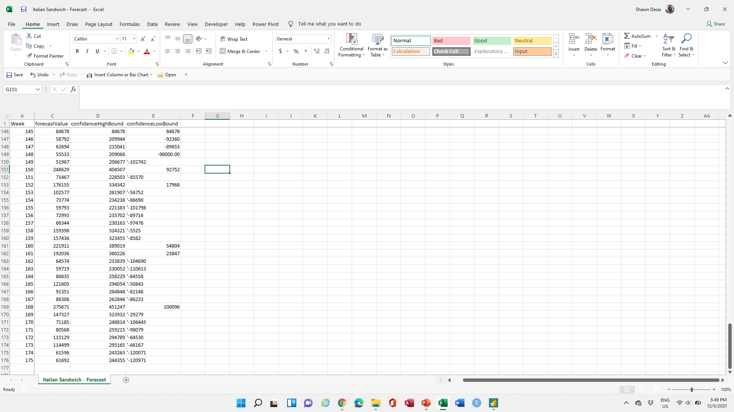
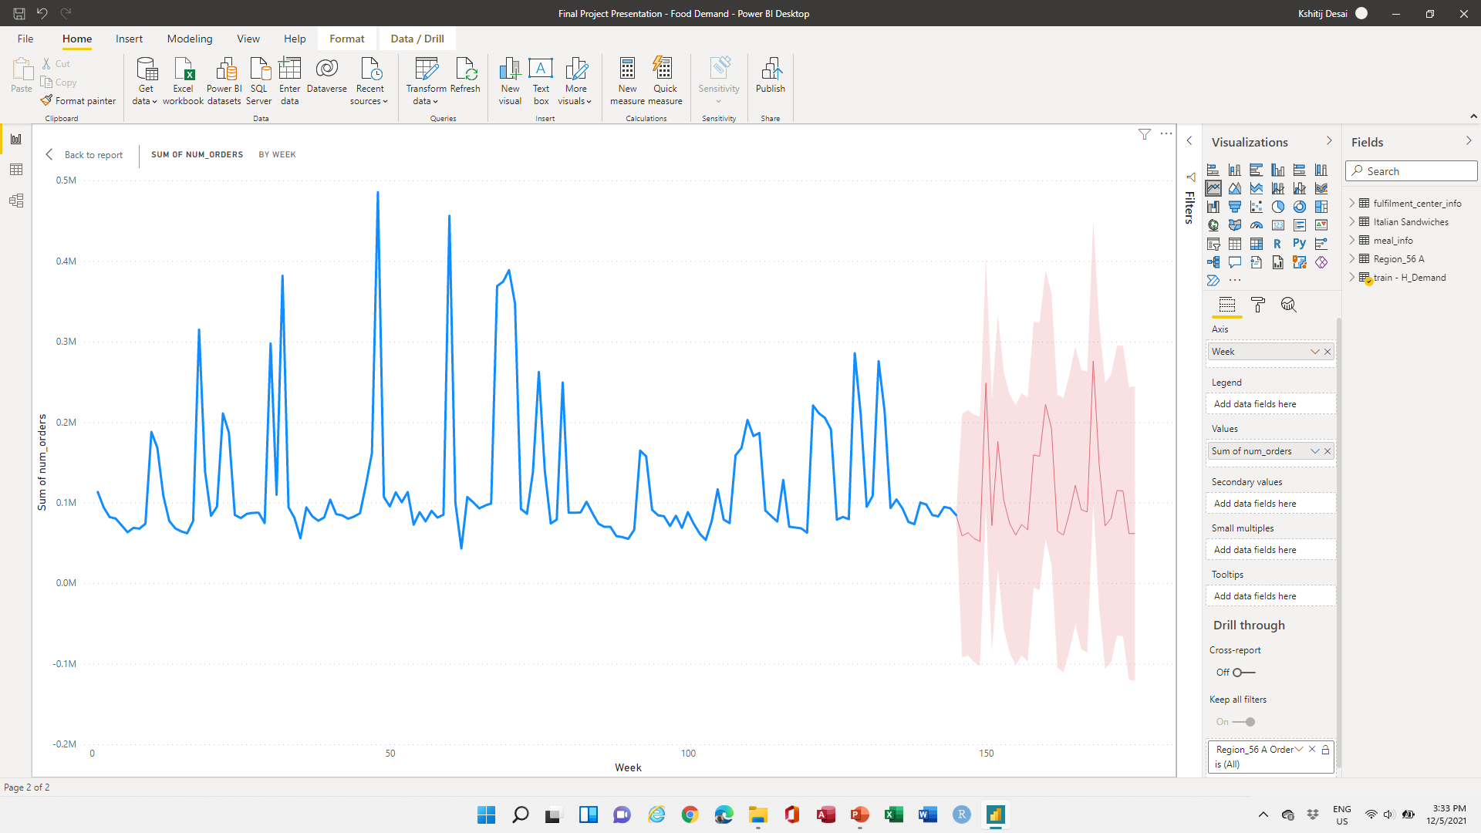
MEAL DISTRIBUTION
Historical Demand
Demand forecast of Italian Sandwiches for 20 weeks. This will be useful to accurately plan raw materials needed in this area.

Slide 6
MEAL DISTRIBUTION
Recommendations
All the region and centre-type orders need to be predicted, especially the regions that have maximum orders in order to plan their staff properly. This is due to the fact that excess, or less staff can impact company sales and profits.
Similarly, popular meal orders need to be predicted in order to avoid extra costs on wastage of raw materials, which are perishable.

